Slide 1

Advanced Genomic Technologies
Relevant to Toxic Tort Litigation

Slide 2

Why Genomic Science?
Disease Characterization
Exposure Assessment
Causation Assessment

Slide 3
Why Genomic Science (cont’d)?
Disease Characterization –
Exposure Assessment - Identifiable and quantitative gene expression profiles, genomic signatures, biomarkers
Predisposition to Disease – Inherited mutation that has been shown to increase risk, independent of exposure (Defense Holy Grail)
Susceptibility to Disease – Our unique genetic makeup may influence susceptibility to toxins. May also help define subgroups where exposure is relevant.
Be Prepared – Plaintiffs may increase reliance on genomics to support toxic tort claims. Be prepared to defend your client.

Slide 4
Genomics Has Been Used
Effectively in the Courtroom
Benzene
Hendrian v. Safety-Kleen Systems, Inc.
Hallquist v. DuPont de Nemours
Tobacco
Tompkin v. American Tobacco
Ionizing Radiation
Guzman v. Exxon Mobil Corp., et al.
Asbestos
Ortwein v Certainteed Corp.

Slide 5
How Genetic and Genomic Technologies Can Influence Causation
Pro-Plaintiff
  Toxin-induced (somatic) mutation induces cancer
Intermediate
  Inherited mutation increases susceptible to cancer (eggshell plaintiff)
  Exposure assessment
Pro-Defense
  Inherited (germline) mutation predisposes to cancer
Exposure-Induced
Cancer
Predisposed Disease
(independent of exposure)

Slide 6
Applying Genomics to Causation
Exposure | Cancer | Relevant Genomic Markers
Benzene | Acute myeloid leukemia (AML) Acute Promyelocytic leukemia (APL) | Chromosomal Translocation (5 →7) (AML) Chromosomal Translocation (15→17) (APL) RUNX1, CEBPA
Ionizing Radiation (IR) | AML | RUNX1, CEBPA, GATA2, TERT, TERC
Talcum Powder | Mesothelioma Ovarian Cancer | BRCA1, BRCA2 GSTT1, GSTM1
Asbestos | Mesothelioma Lung Cancer Other Cancers | BAP1 p53 Epigenetic fingerprint

Slide 7
Asbestos and mesothelioma

Slide 8
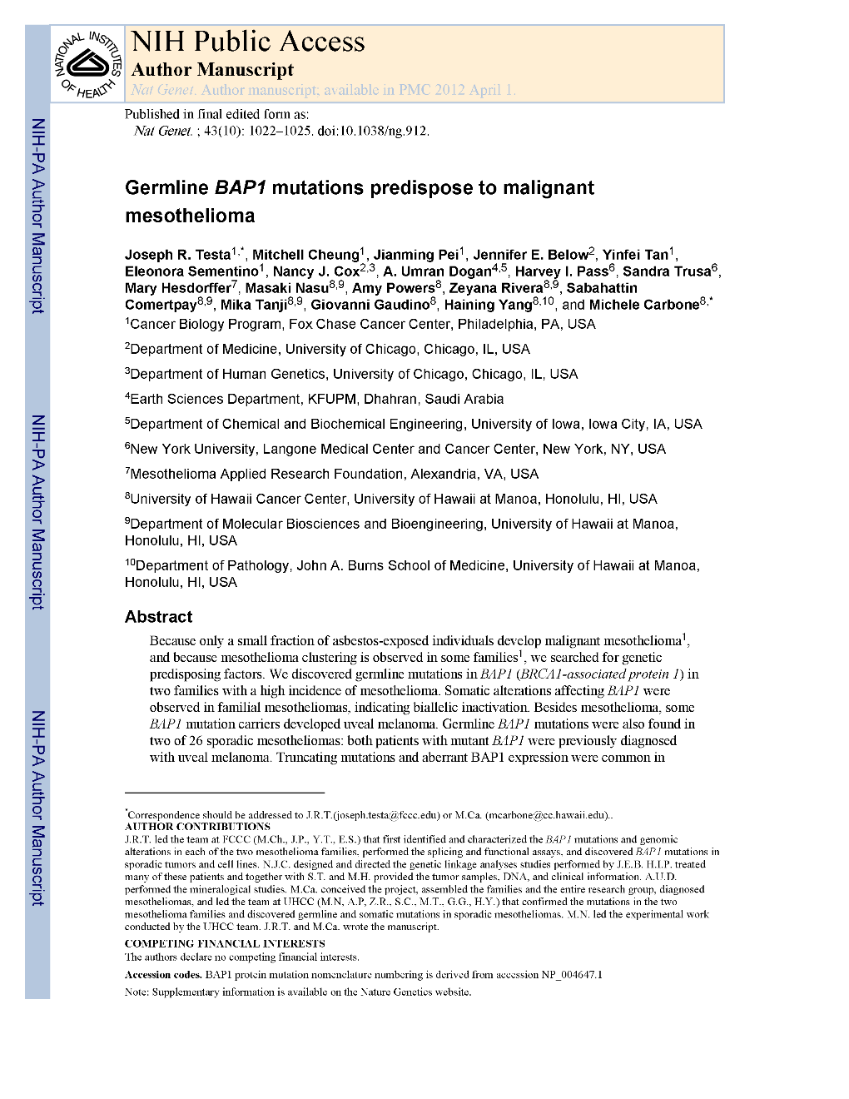
Why is There Such Great Variability in Mesothelioma Susceptibility?
“Some individuals develop mesothelioma following exposure to small amount of asbestos, while others exposed to heavy amounts do not.”

Slide 9
Some BAP1 Milestone
1998
BAP1 Gene Discovered
2010
BAP1 mutations in uveal melanoma
2011
BAP1 mutations in MM tissue & families with MM
2014 - 2015
BAP1 mutant mice predisposed to MM

Slide 10
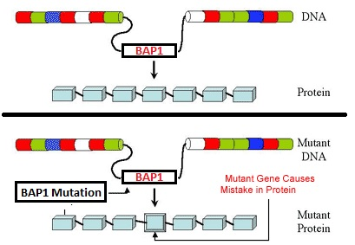
What are BAP1 Mutations?

Slide 11
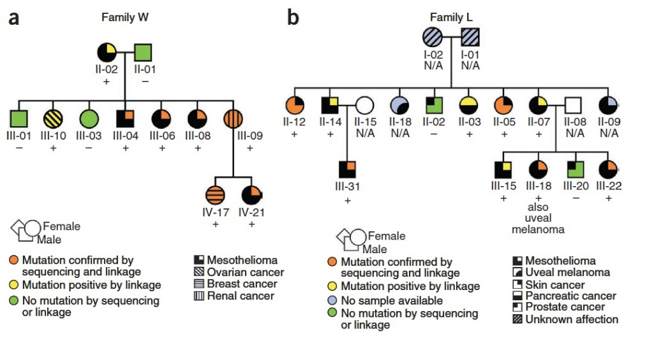
BAP1 Mutations Predispose Families to MM in the Absence of Asbestos Exposure
Testa JR, et al. Germline BAP1 mutations predispose to malignant mesothelioma. Nat Genet. 2011 Aug 28;43(10):1022-5.

Slide 12
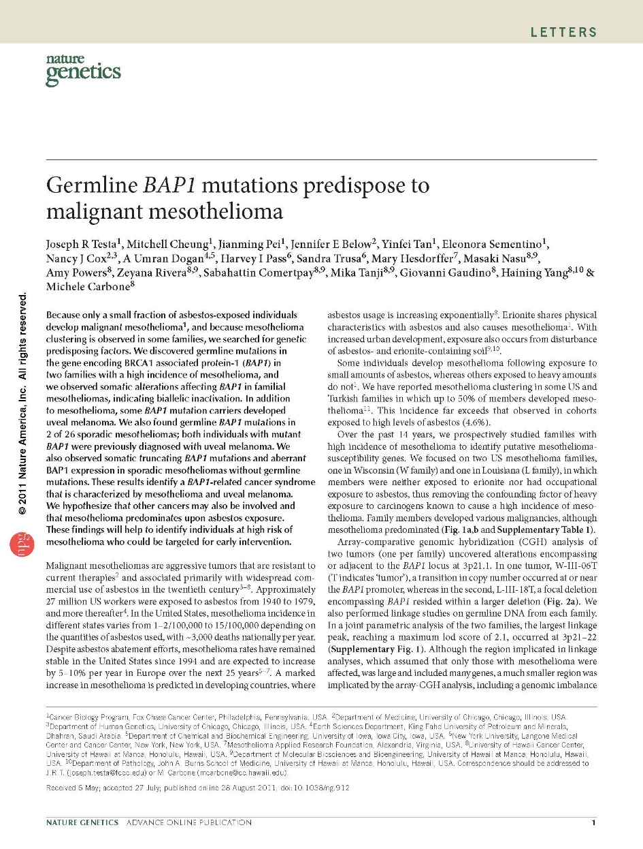
Preordained or Eggshell Plaintiff?
We hypothesize that when individuals with BAP1 mutations are exposed to asbestos, mesothelioma predominates. Alternatively, BAP1 mutation alone may be sufficient to cause mesothelioma.

Slide 13
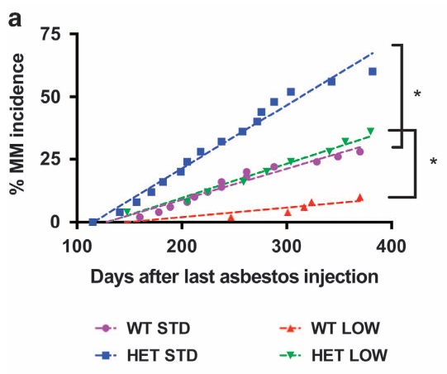
Is BAP1 a Causal Factor in Asbestos-Induced Mesothelioma?
Napolitano A, et al. Minimal asbestos exposure in germline BAP1 heterozygous mice is associated with deregulated inflammatory response and increased risk of mesothelioma. Oncogene. 2015 Jun 29.

Slide 14
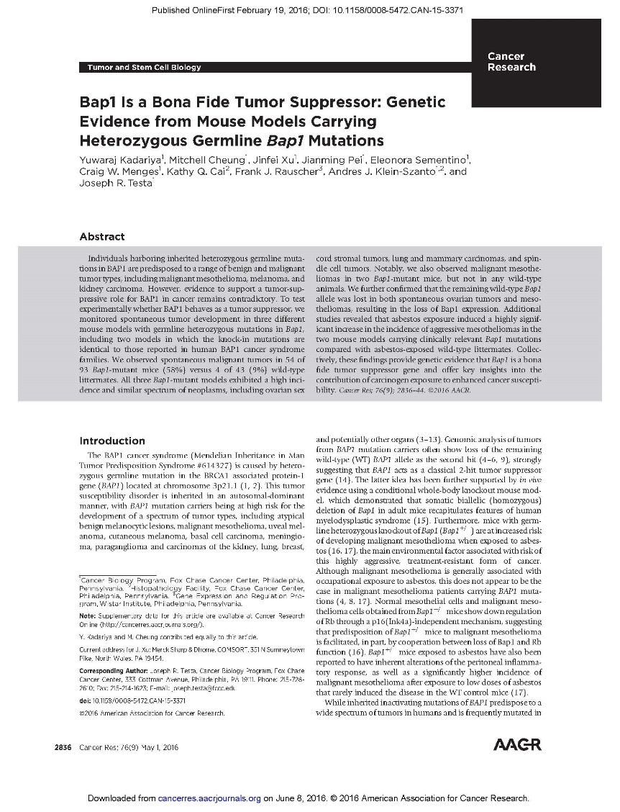
BAP1 Mutations Lead to
Spontaneous MM Tumors
Two spontaneous malignant mesotheliomas were identified in Bap1-mutant mice, whereas none were found in any of the 43 WT mice sacrificed to date…

Slide 15
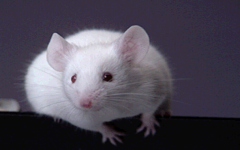
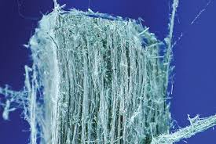
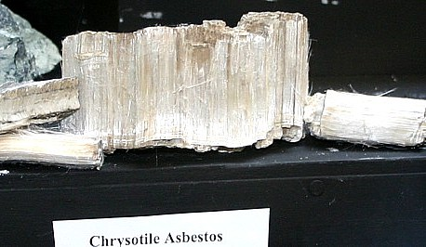
Do BAP1 Mutations Increase Risk for Chrysotile-Induced MM?
↑ MM Risk
Amphibole Asbestos
BAP1 Mutant
???
Chrysotile Asbestos
BAP1 Mutant

Slide 16
Genetic techniques in asbestos and Lung Cancer

Slide 17
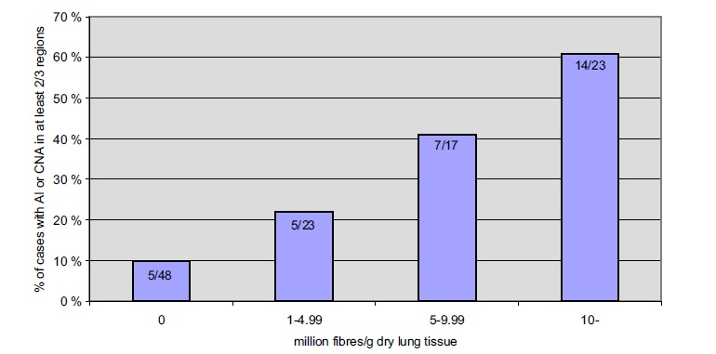
Genomic Markers May Distinguish Asbestos-Induced Lung Tumors
61%
41%
22%
10%
Nymark P, et al. Accumulation of genomic alterations in 2p16, 9q33.1 and 19p13 in lung tumors of asbestos-exposed patients. Mol Oncol. 2013 Feb;7(1):29-40.

Slide 18
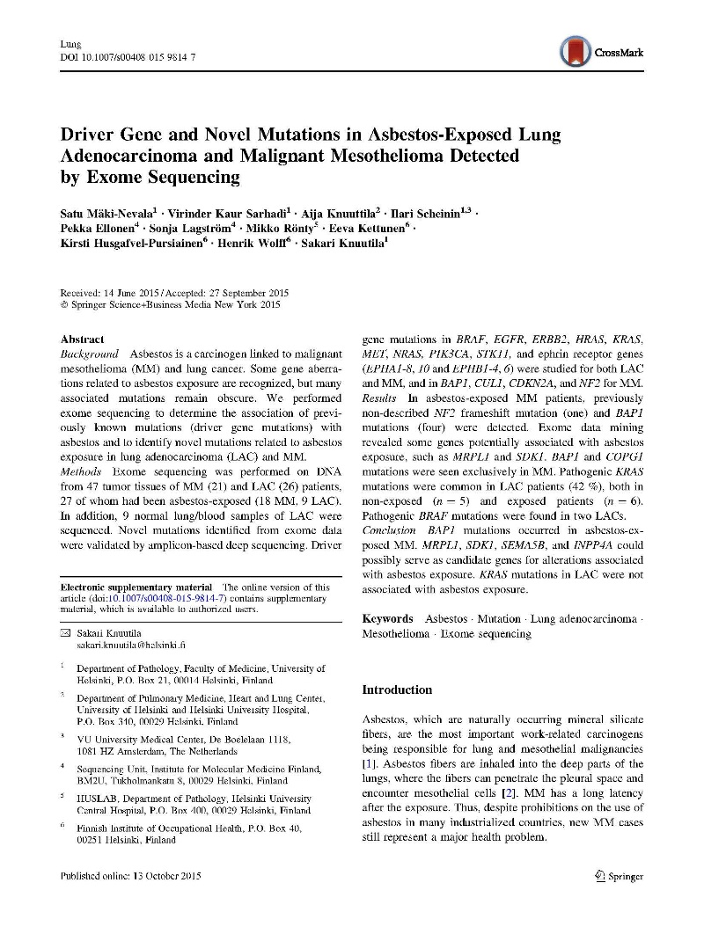
Genomic Study Links Mutations to Smoking but Not to Asbestos
We found pathogenic KRAS mutations… in 42 % of both asbestos-exposed and non-exposed LAC patients, suggesting that these mutations are not linked to exposure to asbestos
Mutations in both of these driver genes showed a putative
association with smoking but not with asbestos.
Mäki-Nevala S, et al. Driver Gene and Novel Mutations in Asbestos-Exposed Lung Adenocarcinoma and Malignant Mesothelioma Detected by Exome Sequencing. Lung. 2015 Oct 13.

Slide 19
Genome Wide Association (GWA) Studies

Slide 20
Genome-Wide Association Studies (GWAS)
May Be Key
Recruit subjects with disease and w/o disease
Obtain DNA
Identify genetic variations
Determine genetic associations
Draw conclusions about genomic patterns relevant to disease and exposure

Slide 21
GWAS Studies Assessing
Asbestos-Related Disease
Author, Year | Title | Disease Examined
Cadby, 2013 | A genome-wide association study for malignant mesothelioma risk | Mesothelioma
Matullo, 2013 | Genetic variants associated with increased risk of malignant pleural mesothelioma: a genome-wide association study | Mesothelioma
Tunesi, 2015 | Gene–asbestos interaction in malignant pleural mesothelioma susceptibility | Mesothelioma
Liu, 2015 | Genome-wide Gene–Asbestos Exposure Interaction Association Study Identifies a Common Susceptibility Variant on 22q13.31 Associated with Lung Cancer Risk | Lung Cancer

Slide 22
GWA Studies on Asbestos Disease Largely Inconclusive
Very little overlap between MM studies
Hint of genomic patterns between and within studies
Asbestos exposure seems to be the biggest risk factor overall

Slide 23
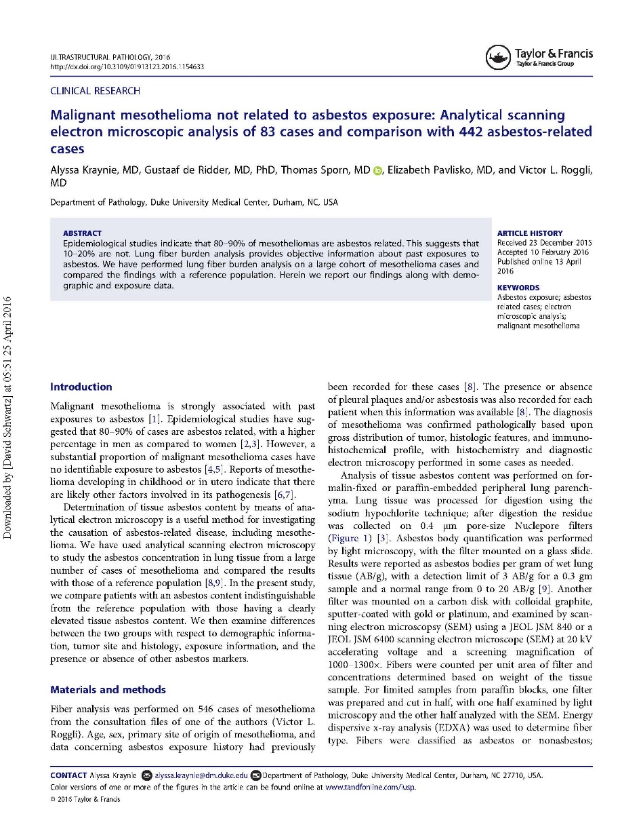
Proper Asbestos Exposure
Assessment is Key

Slide 24
The Ideal GWA Study?
Collect
Disease
No Disease
Analyze
Asbestos
Exposure?
Genetic
Profile
Asbestos
Exposure?
Genetic
Profile
Stats
Seek associations between genomic profiles,
asbestos exposure and disease status
Design animal studies to test
associations for causation
Test

Slide 25

Overall Summary and Conclusions
BAP1: A new and important genomic marker for MM
Lung Cancer: Genomics helps to distinguish asbestos-related from non-asbestos-related cancer
GWA: Powerful tools to find important associations between genes, disease, and exposures

Slide 26
www.innovativescience.net
David Schwartz, PhD - Schwartz@innovativescience.net
Giovanni Ciavarra, PhD – Ciavarra@innovativescience.net
973-889-1600
67 East Park Place
Morristown, NJ
07960

